Slide 1
Database Overview
S511 Session 2, IU-SLIS

Slide 2
Outline
Database
  What, Why, How
Evolution of Database
  File System
  Data Models
    Hierarchical
    Network
    Relational
    Entity-Relationship
    Object-Oriented
  Web Database
S511 Session 2, IU-SLIS

Slide 3
Database: What
Database
  is collection of related data and its metadata organized in a structured format
  for optimized information management
Database Management System (DBMS)
  is a software that enables easy creation, access, and modification of databases
  for efficient and effective database management
Database System
  is an integrated system of hardware, software, people, procedures, and data
  that define and regulate the collection, storage, management, and use of data within a database environment
S511 Session 2, IU-SLIS
Notes:
End user data – raw facts of interests to the end user
Metadata – description of data characteristics and relationships
Organization of data helps:
improve data accuracy
improve timely access
correlation and comparison
DBMS: a collection of programs that manages the database structure, control access to data
- Makes data management more efficient and effective
- Query language allows quick answers to ad hoc queries
- Provides better access to more and better-managed data
- Promotes integrated view of organization’s operations
- Reduces the probability of inconsistent data

Slide 4
Database Management System (DBMS)
DBMS contains information about a particular enterprise
  Collection of interrelated data
  Set of programs to access the data
  An environment that is both convenient and efficient to use
Database Applications:
  Banking: transactions
  Airlines: reservations, schedules
  Universities: registration, grades
  Sales: customers, products, purchases
  Online retailers: order tracking, customized recommendations
  Manufacturing: production, inventory, orders, supply chain
  Human resources: employee records, salaries, tax deductions
Databases can be very large.
Databases touch all aspects of our lives

Slide 5
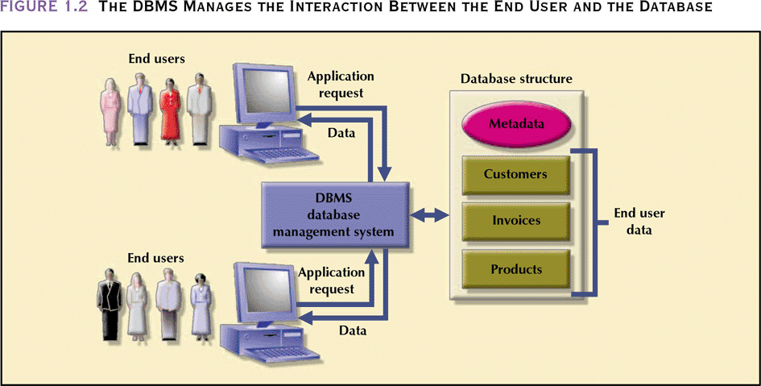
Database Management System
- manages interaction between end users and database
Database Systems: Design, Implementation, & Management: Rob & Coronel
S511 Session 2, IU-SLIS

Slide 6
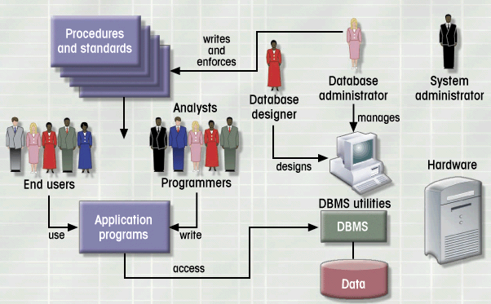
Database System Environment
Hardware
Software
- OS
- DBMS
- Applications
People
Procedures
Data
Database Systems: Design, Implementation, & Management: Rob & Coronel
S511 Session 2, IU-SLIS

Slide 7
Database: Why
Purpose of Database
  Optimizes data management
  Transforms data into information
Importance of Database Design
  Defines the database’s expected use
    different approach needed for different types of databases
  Avoid data redundancy & ensure data integrity
    data is accurate and verifiable
  Poorly designed database generates errors
    leads to bad decisions
    can lead to failure of organization
Functions of DBMS/Database System
  Stores data and related data entry forms, report definitions, etc.
  Hides the complexities of relational database model from the user
    facilitates the construction/definition of data elements and their relationships
    enables data transformation and presentation
  Enforces data integrity
  Implements data security management
    access, privacy, backup & restoration
S511 Session 2, IU-SLIS
Notes:
Importance of Good Design
Poor design results in unwanted data redundancy
Poor design generates errors leading to bad decisions
Practical Approach
Focus on principles and concepts of database design
Importance of logical design

Slide 8
Database: How
Planning & Analysis
  Assess
    Goal of the organization
    Database environment
      existing hardware, software, raw data, data processing procedures
  Identify
    Database needs
      what database can do to further the goal of the organization
    User needs and characteristics
      who the users are, what they want to do, how they envision doing it
    Database system requirements
      what the database system should do to satisfy the database and user needs
Design
  From conceptual design to a detailed system specification
Implementation
  Create the database
Maintenance
  Troubleshoot, update, streamline the database
S511 Session 2, IU-SLIS

Slide 9
Business Rules
What
  Brief, precise, and unambiguous descriptions of operations in an organization
    based on policies, procedures, or principles within a specific organization
    help to create and enforce actions within that organization’s environment
    apply to any organization that stores and uses data to generate information
Why
  Enhance understanding & facilitate communication
    Standardize company’s view of data
    Constitute a communications tool between users and designers
    Allow designer to understand business process as well as the nature, role, and scope of data
  Promote creation of an accurate data model
How (sources)
  Interviews
    Company managers
    Policy makers
    Department managers
    End users
  Written documentation
    Procedures, Standards, Operations manuals
  Observation
    Business operations
S511 Session 2, IU-SLIS

Slide 10
Database: User-centered
Perspective
  The user is always right. If there is a problem with the use of the system, the system is the problem, not the user.
Compliance
  The user has the right to a system that performs exactly as promised.
Instruction
  The user has the right to easy-to-use instructions (user guides, online or contextual help, error messages) for understanding and utilizing a system to achieve desired goals and recover efficiently and gracefully from problem situations.
Usability
  The user should be the master of software and hardware technology, not vice-versa. Products should be natural and intuitive to use.
S511 Session 2, IU-SLIS

Slide 11
Database: Data Models
Importance
  Abstraction of complex real-word data structures in relative simple (graphical) representations
  Facilitate interaction among the designer, the applications programmer, and the end user
Basic Building Blocks
  Entity
    thing about which data are to be collected and stored
  Attribute
    a characteristic of an entity
  Relationship
    describes an association among entities
  Constraint
    restrictions placed on the data
S511 Session 2, IU-SLIS

Slide 12
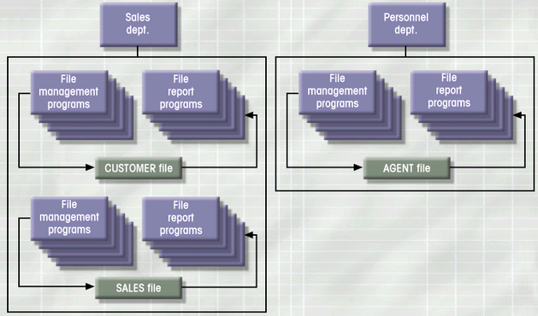
File System: Example
Database Systems: Design, Implementation, & Management: Rob & Coronel
S511 Session 2, IU-SLIS

Slide 13
File System: Weakness
Weakness
  “Islands of data” in scattered file systems.
Problems
  Duplication
    same data may be stored in multiple files
  Inconsistency
    same data may be stored by different names in different format
  Rigidity
    requires customized programming to implement any changes
    cannot do ad-hoc queries
Implications
  Waste of space
  Data inaccuracies
  High overhead of data manipulation and maintenance
S511 Session 2, IU-SLIS

Slide 14
File System: Problem Case
CUSTOMER file
AGENT file
SALES file
A_Name (15 char)
A_Name (20 char)
AGENT (20 char)
Carol Johnson
Carol T. Johnson
Carol J. Smith
- inconsistent field name, field size
- inconsistent data values
- data duplication
S511 Session 2, IU-SLIS

Slide 15
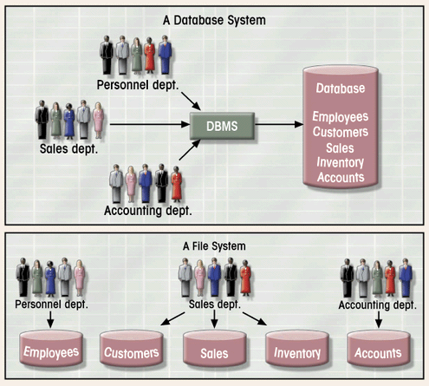
Database System vs. File System
Database Systems: Design, Implementation, & Management: Rob & Coronel
S511 Session 2, IU-SLIS

Slide 16
Drawbacks of using file systems to store data
Data redundancy and inconsistency
  Multiple file formats, duplication of information in different files
Difficulty in accessing data
  Need to write a new program to carry out each new task
Data isolation
  Multiple files and formats
Integrity problems
  Integrity constraints (e.g., account balance > 0) become “buried” in program code rather than being stated explicitly
  Hard to add new constraints or change existing ones

Slide 17
Drawbacks of using file systems to store data (Cont.)
Atomicity of updates
  Failures may leave database in an inconsistent state with partial updates carried out
  Example: Transfer of funds from one account to another should either complete or not happen at all
Concurrent access by multiple users
  Concurrent access needed for performance
  Uncontrolled concurrent accesses can lead to inconsistencies
    Example: Two people reading a balance (say 100) and updating it by withdrawing money (say 50 each) at the same time
Security problems
  Hard to provide user access to some, but not all, data
Database systems offer solutions to all the above problems

Slide 18
Classification of DBMSs
Based on the data model used
  Traditional: Relational, Network, Hierarchical.
  Emerging: Object-oriented, Object-relational.
Other classifications
  Single-user (typically used with personal computers)
  vs. multi-user (most DBMSs).
  Centralized (uses a single computer with one database)
  vs. distributed (uses multiple computers, multiple databases)
Slide 2- <number>

Slide 19
Advantages of Using the Database Approach
Controlling redundancy in data storage and in development and maintenence efforts.
Sharing of data among multiple users.
Restricting unauthorized access to data.
Providing persistent storage for program Objects (in Object-oriented DBMS’s –
Providing Storage Structures for efficient Query Processing
Slide 1-<number>

Slide 20
Advantages of Using the Database Approach
Providing backup and recovery services.
Providing multiple interfaces to different classes of users.
Representing complex relationships among data.
Enforcing integrity constraints on the database.
Drawing Inferences and Actions using rules
Slide 1-<number>

Slide 21
DBMS Languages
DDL - Data Definition Language is used to define both schemas.
VDL - View Definition Language is used to specify the mapping of the user views to the conceptual schema.
DML - Data Manipulation Language is used to provide a means to manipulate the database. (I.e. insert, delete, query,etc)
Chapter 2

Slide 22
Most DBMS’s combine the various capabilities of the DDL, VDL, DML and SDL into a single high-level DML (e.g. SQL relational database language.)
Such DML’s can generally be entered interactively from the terminal or embedded in a high-level language such as C which acts as a host language.
Chapter 2

Slide 23
DBMS Languages
Data Manipulation Language (DML):
  Used to specify database retrievals and updates
  DML commands (data sublanguage) can be embedded in a general-purpose programming language (host language), such as COBOL, C, C++, or Java.
    A library of functions can also be provided to access the DBMS from a programming language
  Alternatively, stand-alone DML commands can be applied directly (called a query language).
Slide 2- <number>

Slide 24
Types of DML
High Level or Non-procedural Language:
  For example, the SQL relational language
  Are “set”-oriented and specify what data to retrieve rather than how to retrieve it.
  Also called declarative languages.
Low Level or Procedural Language:
  Retrieve data one record-at-a-time;
  Constructs such as looping are needed to retrieve multiple records, along with positioning pointers.
Slide 2- <number>

Slide 25
DBMS Languages
Data Definition Language (DDL)
Data Manipulation Language (DML)
  High-Level or Non-procedural Languages: These include the relational language SQL
    May be used in a standalone way or may be embedded in a programming language
  Low Level or Procedural Languages:
    These must be embedded in a programming language
Slide 2- <number>

Slide 26
DBMS Component Modules
A typical DBMS consists of the following components:
  DDL compiler: process schema definitions, specified in the DDL statements, and stores descriptions of the schemas in the system catalog.
  DML compiler: compiles the DML commands into object code for database access.
  Run-time database processor: handles database access at run time. It receives retrieval and update operations and carries them out on the database.
  Query compiler: handles high-level queries that are entered interactively.
  Data manager: controls access to DBMS information that is stored on disk through interaction with operating system.
Slide 2- <number>

Slide 27

DBMS Component modules
Slide 2- <number>

Slide 28
Database administrators (DBAs) use specialized software to store and organize data.
The role may include capacity planning, installation, configuration, database design, migration, performance monitoring, security, troubleshooting, as well as backup and data recovery.
A database administrator's responsibilities can include the following tasks:
Installing and upgrading the database server and application tools
Allocating system storage and planning future storage requirements for the database system
Modifying the database structure, as necessary, from information given by application developers
Enrolling users and maintaining system security
Controlling and monitoring user access to the database
Monitoring and optimizing the performance of the database
Planning for backup and recovery of database information
Backing up and restoring databases
Generating various reports by querying from database as per need
S511 Session 2, IU-SLIS

Slide 29
Categories of Data Models
Conceptual (high-level, semantic) data models:
  Provide concepts that are close to the way many users perceive data.
    (Also called entity-based or object-based data models.)
Physical (low-level, internal) data models:
  Provide concepts that describe details of how data is stored in the computer. These are usually specified in an ad-hoc manner through DBMS design and administration manuals
Implementation (representational) data models:
  Provide concepts that fall between the above two, used by many commercial DBMS implementations (e.g. relational data models used in many commercial systems).
Slide 2- <number>

Slide 30
High-level ( or conceptual) data models closely approximate the miniworld.
Representational ( or, implementational ) data models are intermediate data models close to the miniworld but also reflecting the actual organization of data in the database.
Low-level ( or, physical) data models describe details of physical storage, generally transparent to casual or parametric end users.
Chapter 2

Slide 31
History of Data Models
Network Model
Hierarchical Model
Relational Model
Object-oriented Data Models
Object-Relational Models
Slide 2- <number>

Slide 32
Hierarchical Database
Background
  Developed to manage large amount of data for complex manufacturing projects
  e.g., Information Management System (IMS)
    IBM-Rockwell joint venture
    clustered related data together
    hierarchically associated data clusters using pointers
Hierarchical Database Model
  Assumes data relationships are hierarchical
    One-to-Many (1:M) relationships
      Each parent can have many children
      Each child has only one parent
  Logically represented by an upside down tree
S511 Session 2, IU-SLIS

Slide 33
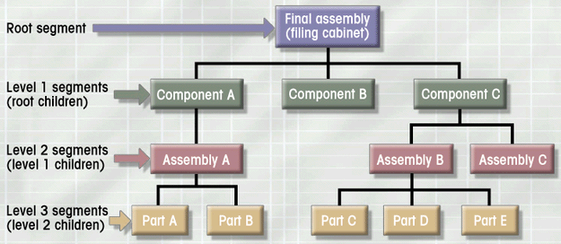
Hierarchical Database: Example
Database Systems: Design, Implementation, & Management: Rob & Coronel
S511 Session 2, IU-SLIS

Slide 34
Hierarchical Database: Pros & Cons
Advantages
  Conceptual simplicity
    groups of data could be related to each other
    related data could be viewed together
  Centralization of data
    reduced redundancy and promoted consistency
Disadvantages
  Limited representation of data relationships
    did not allow Many-to-Many (M:N) relations
  Complex implementation
    required in-depth knowledge of physical data storage
  Structural Dependence
    data access requires physical storage path
  Lack of Standards
    limited portability
S511 Session 2, IU-SLIS

Slide 35
Network Database
Objectives
  Represent more complex data relationships
  Improve database performance
  Impose a database standard
Network Database Model
  Similar to Hierarchical Model
    Records linked by pointers
  Composed of sets
    Each set consists of owner (parent) and member (child)
  Many-to-Many (M:N) relationships representation
    Each owner can have multiple members (1:M)
    A member may have several owners
S511 Session 2, IU-SLIS

Slide 36
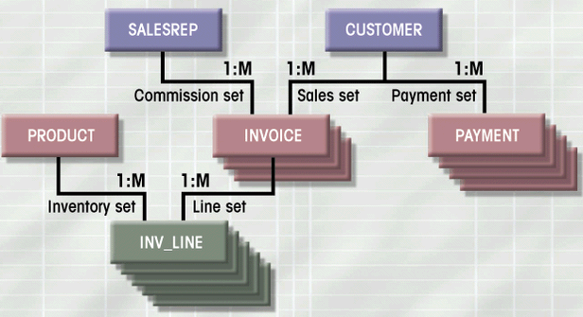
Network Database: Example
Database Systems: Design, Implementation, & Management: Rob & Coronel
S511 Session 2, IU-SLIS

Slide 37
Network Database: Pros & Cons
Advantages
  More data relationship types
  More efficient and flexible data access
    “network” vs. “tree” path traversal
  Conformance to standards
    enhanced database administration and portability
Disadvantages
  System complexity
    require familiarity with the internal structure for data access
  Lack of structural independence
    small structural changes require significant program changes
S511 Session 2, IU-SLIS
Notes:
disadvantages left over from hierarchical model

Slide 38
Relational Database
Problems with legacy database systems
  Required excessive effort to maintain
    Data manipulation (programs) too dependent on physical file structure
  Hard to manipulate by end-users
    No capacity for ad-hoc query (must rely on DB programmers).
Evolution in Data Organization
  E. F. Codd’s Relational Model proposal
    Separated the notion of physical representation (machine-view)
    from logical representation (human-view)
    Considered ingenious but computationally impractical in 1970
  Relational Database Model
    Dominant database model of today
    Eliminated pointers and used tables to represent data
    Tables
      flexible logical structure for data representation
      a series of row/column intersections
      related by sharing common entity characteristic(s)
S511 Session 2, IU-SLIS

Slide 39
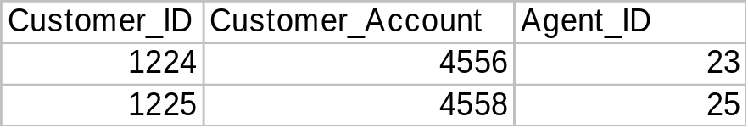
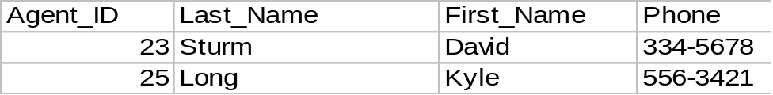
Relational Database: Example
Provides a logical “human-level” view of the data and associations among groups of data (i.e., tables)
S511 Session 2, IU-SLIS

Slide 40
Relational Database: Pros & Cons
Advantages
  Structural independence
    Separation of database design and physical data storage/access
    Easier database design, implementation, management, and use
  Ad hoc query capability with Structured Query Language (SQL)
    SQL translates user queries to codes
Disadvantages
  Substantial hardware and system software overhead
    more complex system
  Poor design and implementation is made easy
    ease-of-use allows careless use of RDBMS
S511 Session 2, IU-SLIS

Slide 41
Entity Relationship Model
Peter Chen’s Landmark Paper in 1976
  “The Relationship Model: Toward a Unified View of Data”
  Graphical representation of entities and their relationships
Entity Relationship (ER) Model
  Based on Entity, Attributes & Relationships
    Entity is a thing about which data are to be collected and stored
      e.g. EMPLOYEE
    Attributes are characteristics of the entity
      e.g. SSN, last name, first name
    Relationships describe an associations between entities
      i.e. 1:M, M:N, 1:1
  Complements the relational data model concepts
    Helps to visualize structure and content of data groups
      entity is mapped to a relational table
    Tool for conceptual data modeling (higher level representation)
  Represented in an Entity Relationship Diagram (ERD)
    Formalizes a way to describe relationships between groups of data
S511 Session 2, IU-SLIS

Slide 42
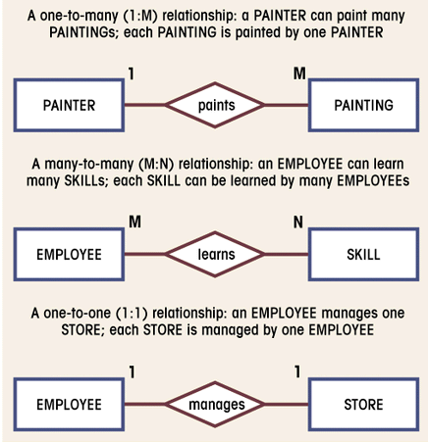
E-R Diagram: Chen Model
Entity
  represented by a rectangle with its name in capital letters.
Relationships
  represented by an active or passive verb inside the diamond that connects the related entities.
Connectivities
  i.e., types of relationship
  written next to each entity box.
Database Systems: Design, Implementation, & Management: Rob & Coronel
S511 Session 2, IU-SLIS

Slide 43
E-R Model: Pros & Cons
Advantages
  Exceptional conceptual simplicity
    easily viewed and understood representation of database
    facilitates database design and management
  Integration with the relational database model
    enables better database design via conceptual modeling
Disadvantages
  Incomplete model on its own
    Limited representational power
      cannot model data constraints not tied to entity relationships
        e.g. attribute constraints
      cannot represent relationships between attributes within entities
    No data manipulation language (e.g. SQL)
  Loss of information content
    Hard to include attributes in ERD
S511 Session 2, IU-SLIS

Slide 44
Object-Oriented Database
Semantic Data Model (SDM)
  Modeled both data and their relationships in a single structure (object)
    Developed by Hammer & McLeod in 1981
Object-oriented concepts became popular in 1990s
  Modularity facilitated program reuse and construction of complex structures
  Ability to handle complex data types (e.g. multimedia data)
Object-Oriented Database Model (OODBM)
  Maintains the advantages of the ER model but adds more features
  Object = entity + relationships (between & within entity)
    consists of attributes & methods
      attributes describe properties of an object
      methods are all relevant operations that can be performed on an object
    self-contained abstraction of real-world entity
  Class = collection of similar objects with shared attributes and methods
    e.g. EMPLOYEE class = (employ1 object, employ2 object, …)
    organized in a class hierarchy
      e.g. PERSON > EMPLOYEE, CUSTOMER
  Incorporates the notion of inheritance
    attributes and methods of a class are inherited by its descendent classes
S511 Session 2, IU-SLIS

Slide 45
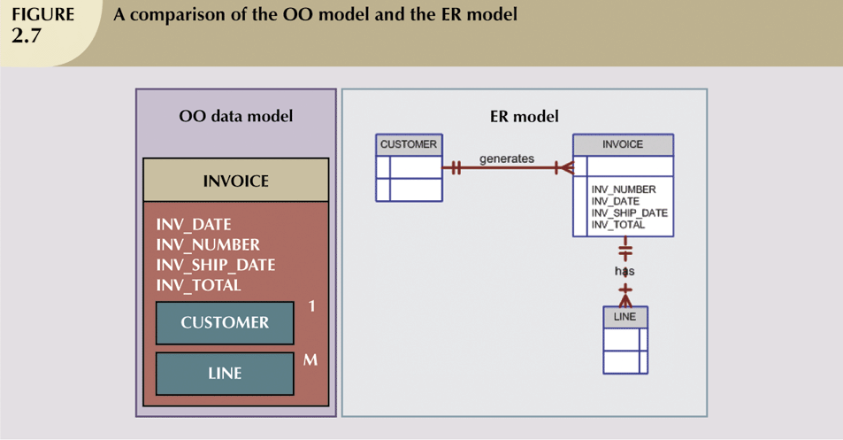
OO Database Model vs. E-R Model
OODBM:
- can accommodate relationships within a object
- objects to be used as building blocks for autonomous structures
Database Systems: Design, Implementation, & Management: Rob & Coronel
S511 Session 2, IU-SLIS

Slide 46
Object-Oriented Database: Pros & Cons
Advantages
  Semantic representation of data
    fuller and more meaningful description of data via object
  Modularity, reusability, inheritance
  Ability to handle
    complex data
    sophisticated information requirements
Disadvantages
  Lack of standards
    no standard data access method
  Complex navigational data access
    class hierarchy traversal
  Steep learning curve
    difficult to design and implement properly
  More system-oriented than user-centered
  High system overhead
    slow transactions
S511 Session 2, IU-SLIS

Slide 47
Web Database
Internet is emerging as a prime business tool
  Shift away from models (e.g. relational vs. O-O)
  Emphasis on interfacing with the Internet
Characteristics of “Internet age” databases
  Flexible, efficient, and secure Internet access
  Support for complex data types & relationships
  Seamless interfaces with multiple data sources and structures
  Ease of use for end-user, database architect, and database administrator
    Simplicity of conceptual database model
    Many database design, implementation, and application development tools
    Powerful DBMS GUI
S511 Session 2, IU-SLIS

Slide 48
Schemas versus Instances
Database Schema:
  The description of a database.
  Includes descriptions of the database structure, data types, and the constraints on the database.
Schema Diagram:
  An illustrative display of (most aspects of) a database schema.
Schema Construct:
  A component of the schema or an object within the schema, e.g., STUDENT, COURSE.
Slide 2- <number>

Slide 49

Example of a Database Schema
Slide 2- <number>

Slide 50

Example of a database state
Slide 2- <number>

Slide 51
Schemas versus Instances
Database State:
  The actual data stored in a database at a particular moment in time. This includes the collection of all the data in the database.
  Also called database instance (or occurrence or snapshot).
    The term instance is also applied to individual database components, e.g. record instance, table instance, entity instance
Slide 2- <number>

Slide 52
Database State
The actual data in a data base at a particular instant is the database state, which consists of a set of instances for each schema construct.
Defining a database consists of specifying a schema to the DBMS. We then have a database in an empty state, with no data.
Chapter 2

Slide 53
Centralized and
Client-Server DBMS Architectures
Centralized DBMS:
  Combines everything into single system including- DBMS software, hardware, application programs, and user interface processing software.
  User can still connect through a remote terminal – however, all processing is done at centralized site.
Slide 2- <number>

Slide 54

A Physical Centralized Architecture
Slide 2- <number>

Slide 55
Two Tier Client-Server Architecture
A client program may connect to several DBMSs, sometimes called the data sources.
In general, data sources can be files or other non-DBMS software that manages data.
Other variations of clients are possible: e.g., in some object DBMSs, more functionality is transferred to clients including data dictionary functions, optimization and recovery across multiple servers, etc.
Slide 2- <number>

Slide 56

Logical two-tier client server architecture
Slide 2- <number>

Slide 57
Basic 2-tier Client-Server Architectures
Specialized Servers with Specialized functions
  Print server
  File server
  DBMS server
  Web server
  Email server
Clients can access the specialized servers as needed
Slide 2- <number>

Slide 58
Clients
Provide appropriate interfaces through a client software module to access and utilize the various server resources.
Clients may be diskless machines or PCs or Workstations with disks with only the client software installed.
Connected to the servers via some form of a network.
  (LAN: local area network, wireless network, etc.)
Slide 2- <number>

Slide 59
DBMS Server
Provides database query and transaction services to the clients
Relational DBMS servers are often called SQL servers, query servers, or transaction servers
Applications running on clients utilize an Application Program Interface (API) to access server databases via standard interface such as:
  ODBC: Open Database Connectivity standard
  JDBC: for Java programming access
Client and server must install appropriate client module and server module software for ODBC or JDBC
Slide 2- <number>

Slide 60
Three Tier Client-Server Architecture
Common for Web applications
Intermediate Layer called Application Server or Web Server:
  Stores the web connectivity software and the business logic part of the application used to access the corresponding data from the database server
  Acts like a conduit for sending partially processed data between the database server and the client.
Three-tier Architecture Can Enhance Security:
  Database server only accessible via middle tier
  Clients cannot directly access database server
Slide 2- <number>

Slide 61

Three-tier client-server architecture
Slide 2- <number>

Slide 62
ANSI/SPARC architecture:-Three-Schema Architecture
American National standard Institute established a study group on DBMS for standard planning with the mission of feasibility study of setting up standards in this area.
- ANSI/SPARC is a three- schema architecture based on data organization consists of three level (views of data)
- external view (user) - highest level, users’ view of a
portion of the DB and relationships among data
-conceptual view (enterprise) - abstract definition of the
DB, the ‘real world’ view. Represents data without
considering the application or the storage requirements
-internal view (system) - lowest level, physical definition,
storage issues

Slide 63

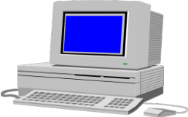
American National Standards Institute(ANSI)/ Standard planning and Requirement Committee(SPARC) Architecture
Users
External
Schema
External
view
External
view
External
view
  External View,
    which is that of the user, who might be a programmer
    basically concerned with how users view the data.
  Conceptual view,
Conceptual
Schema
  Internal View,
    that of a system or a machine,
    deals with the physical definition and organization of data.
Conceptual
Schema
Conceptual
view
Internal
Schema
Internal view

Slide 64
Three-Schema Architecture
Defines DBMS schemas at three levels:
  Internal schema at the internal level to describe physical storage structures and access paths (e.g indexes).
    Typically uses a physical data model.
  Conceptual schema at the conceptual level to describe the structure and constraints for the whole database for a community of users.
    Uses a conceptual or an implementation data model.
  External schemas at the external level to describe the various user views.
    Usually uses the same data model as the conceptual schema.
Slide 2- <number>

Slide 65
Conceptual Schema Definition
  RELATION PROJ [
    KEY = {PNO}
    ATTRIBUTES = {
      PNO : CHARACTER(7)
      PNAME : CHARACTER(20)
      BUDGET : NUMERIC(7)
    }
  ]
  RELATION ASG [
    KEY = {ENO,PNO}
    ATTRIBUTES = {
      ENO : CHARACTER(9)
      PNO : CHARACTER(7)
      RESP : CHARACTER(10)
      DUR : NUMERIC(3)
    }
  ]

Slide 66
Internal Schema Definition
  RELATION EMP [
    KEY = {ENO}
    ATTRIBUTES = {
      ENO : CHARACTER(9)
      ENAME : CHARACTER(15)
      TITLE : CHARACTER(10)
    }
  ]
  ⇓
  INTERNAL_REL EMPL [
    INDEX ON E# CALL EMINX
    FIELD = {
      HEADER : BYTE(1)
      E# : BYTE(9)
      ENAME : BYTE(15)
      TIT : BYTE(10)
    }
  ]

Slide 67
External View Definition – Example 1
Create a BUDGET view from the PROJ relation
      CREATE VIEW BUDGET(PNAME, BUD)
      AS SELECT PNAME, BUDGET
      FROM PROJ

Slide 68
External View Definition – Example 2
Create a Payroll view from relations EMP and TITLE_SALARY
  CREATE VIEW PAYROLL (ENO, ENAME, SAL)
  AS SELECT EMP.ENO,EMP.ENAME,PAY.SAL
    FROM EMP, PAY
    WHERE EMP.TITLE = PAY.TITLE

Slide 69

The three-schema architecture
Slide 2- <number>

Slide 70
Three-Schema Architecture
Proposed to support DBMS characteristics of:
  Program-data independence.
  Support of multiple views of the data.
The three-schema architecture can be used to further explain the concept of data independence, which can be defined as the capacity to change the schema at one level of a database system without having to change the schema at the next higherlevel.We can define two types of data independence:
Slide 2- <number>

Slide 71
Three-Schema Architecture
Mappings among schema levels are needed to transform requests and data.
  Programs refer to an external schema, and are mapped by the DBMS to the internal schema for execution.
  Data extracted from the internal DBMS level is reformatted to match the user’s external view (e.g. formatting the results of an SQL query for display in a Web page)
Slide 2- <number>

Slide 72
Data Independence
Logical Data Independence:
  The capacity to change the conceptual schema without having to change the external schemas and their associated application programs.
Physical Data Independence:
  The capacity to change the internal schema without having to change the conceptual schema.
  For example, the internal schema may be changed when certain file structures are reorganized or new indexes are created to improve database performance
Slide 2- <number>

Slide 73
Data Mining
The discovery of new information in terms of patterns or rules from vast amounts of data.
The process of finding interesting structure in data.
The process of employing one or more computer learning techniques to automatically analyze and extract knowledge from data.

Slide 74


What Is Data Mining?
Data mining (knowledge discovery from data)
  Extraction of interesting ( previously unknown and potentially useful) patterns or knowledge from huge amount of data
Alternative names
  Knowledge discovery (mining) in databases (KDD), knowledge extraction, data/pattern analysis, data archeology, data dredging, information harvesting, business intelligence, etc.

Slide 75
Data Mining Applications
Marketing
  Marketing strategies and consumer behavior
Finance
  Fraud detection, creditworthiness and investment analysis
Manufacturing
  Resource optimization
Health
  Image analysis, side effects of drug, and treatment effectiveness

Slide 76
Data Warehousing
The data warehouse is a historical database designed for decision support.
Data mining can be applied to the data in a warehouse to help with certain types of decisions.
Proper construction of a data warehouse is fundamental to the successful use of data mining.

Slide 77
What is a Data Warehouse?
A Practitioners Viewpoint
“A data warehouse is simply a single, complete, and consistent store of data obtained from a variety of sources and made available to end users in a way they can understand and use it in a business context.”
-- Barry Devlin, IBM Consultant
CSE601

Slide 78
What is a Data Warehouse?
An Alternative Viewpoint
“A DW is a
  subject-oriented,
  integrated,
  time-varying,
  non-volatile
collection of data that is used primarily in organizational decision making.”
-- W.H. Inmon, Building the Data Warehouse, 1992
CSE601

Slide 79
A Data Warehouse is...
Stored collection of diverse data
  A solution to data integration problem
  Single repository of information
Subject-oriented
  Organized by subject, not by application
  Used for analysis, data mining, etc.
Optimized differently from transaction-oriented db
User interface aimed at executive
CSE601

Slide 80
… Cont’d
Large volume of data (Gb, Tb)
Non-volatile
  Historical
  Time attributes are important
Updates infrequent
May be append-only
Examples
  All transactions ever at Sainsbury’s
  Complete client histories at insurance firm
  LSE financial information and portfolios
CSE601

Slide 81
Generic Warehouse Architecture
Client
Client
Query & Analysis
Design Phase
Loading
Warehouse
Metadata
Maintenance
Integrator
Optimization
Extractor/
Monitor
Extractor/
Monitor
Extractor/
Monitor
...
CSE601

Slide 82
Knowledge Discovery (KDD) Process
Knowledge
  Data mining—core of knowledge discovery process
Pattern Evaluation
Data Mining
Task-relevant Data
Data Warehouse
Selection
Data Cleaning
Data Integration
Databases

Slide 83
Big data is data sets that are so voluminous and complex that traditional data processing application software are inadequate to deal with them. Big data challenges include capturing data, data storage, data analysis, search, sharing, transfer, visualization, querying, updating and information privacy. There are five dimensions to big data known as Volume, Variety, Velocity and the recently added Veracity and Value.
While the term “big data” is relatively new, the act of gathering and storing large amounts of information for eventual analysis is ages old. The concept gained momentum in the early 2000s .
Big Data:
S511 Session 2, IU-SLIS

Slide 84
Volume. Organizations collect data from a variety of sources, including business transactions, social media and information from sensor or machine-to-machine data. In the past, storing it would’ve been a problem – but new technologies (such as Hadoop) have eased the burden.
Velocity. Data streams in at an unprecedented speed and must be dealt with in a timely manner. sensors and smart metering are driving the need to deal with torrents of data in near-real time.
Variety. Data comes in all types of formats – from structured, numeric data in traditional databases to unstructured text documents, email, video, audio, stock ticker data and financial transactions
Big Data Contd..
S511 Session 2, IU-SLIS

Slide 85



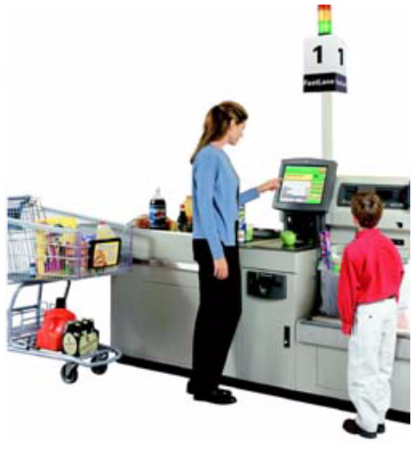
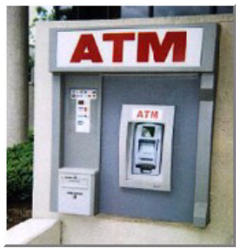
Big Data EveryWhere!
Lots of data is being collected
and warehoused
  Web data, e-commerce
  purchases at department/
  grocery stores
  Bank/Credit Card
  transactions
  Social Network

Slide 86

How much data?
Google processes 20 PB a day (2008)
Wayback Machine has 3 PB + 100 TB/month (3/2009)
Facebook has 2.5 PB of user data + 15 TB/day (4/2009)
eBay has 6.5 PB of user data + 50 TB/day (5/2009)
CERN’s Large Hydron Collider (LHC) generates 15 PB a year
640K ought to be enough for anybody.

Slide 87
Type of Data
Relational Data (Tables/Transaction/Legacy Data)
Text Data (Web)
Semi-structured Data
Graph Data
  Social Network, Semantic Web , …

Slide 88
What to do with these data?
Aggregation and Statistics
  Data warehouse
Indexing, Searching, and Querying
  Keyword based search
  Pattern matching
Knowledge discovery
  Data Mining
  Statistical Modeling

